Slide 1

Analisi isotopica degli isotopi stabili nel suolo: nuove prospettive per la comprensione dei cicli biogeochimici in ecosistemi agrari

Slide 2
Let’s introduce stable isotopes:
Principles of stable isotope ratios analysis
Natural isotopic abundance
Applications

Slide 3
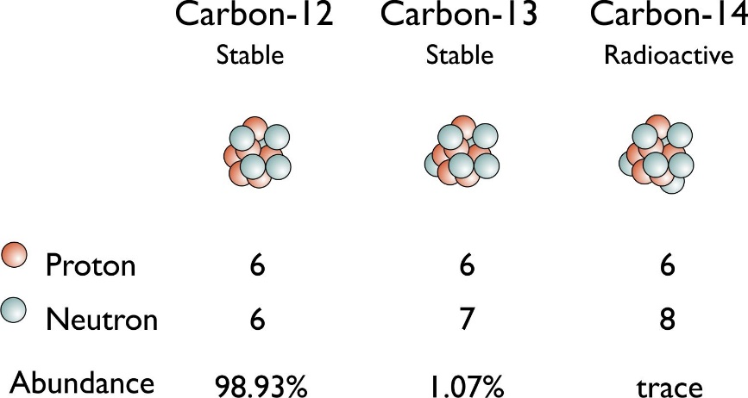
INTRODUCTION
Isotopes of the same element have same number of protons
different number of neutrons
Isotopes of the major Bio elements
C | → | ¹²C, ¹³C
N | → | ¹⁴N, ¹⁵N
S | → | ³²S, ³⁴S
O | → | ¹⁶O, ¹⁸O
H | → | ¹H, ²H
Sr | → | ⁸⁴Sr, ⁸⁶Sr, ⁸⁷Sr, ⁸⁸Sr

Slide 4
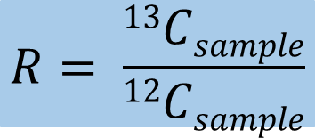
INTRODUCTION
Isotopic fractionation
“Isotopic fractionation is defined as the relative partitioning of the heavier and lighter isotopes between two coexisting phases in a natural system.”
(Tiwari et al., 2015)
Isotopic ratio
$$R= \frac{13Csample}{12Csample}$$

Slide 5



Isotopic ratio
INTRODUCTION
$$R= \frac{13Csample}{12Csample}$$
Isotopic delta
δ¹³C |  |  | → | V-PDB | Fossil
δ¹⁵N |  |  | → | Air | Air
δ³⁴S |  |  | → | V-CDT | Mineral
δ¹⁸O |  |  | → | V-SMOW | Water
δ²H |  |  | → | V-SMOW | Water

Slide 6
INTRODUCTION
Isotope Ratio Mass Spectrometry
IRMS
Elemental Analyser
(EA)
Gas Chromatographer
(GC)
Liquid Chromatographer
(LC)
A. Electronic Impact Ionization Source
B. Magnetic-sector Mass Analyser
C. Faraday Detectors
D. Analog Electromers

Slide 7
ISOTOPIC VARIABILITY
What are the factors of influence on the isotopic values?
?
?
?
?
?
?
?
?
?
?
?
?
δ^{n}X
?
?
?
?
?
?
?
?
?
?
?
?

Slide 8
δ¹³C
frequency
carbon isotopic ratio (‰, vs v-PDB)
watkins et al. 2017

Slide 9








Precipitations
Warm and arid climate
promote higher δ¹⁵N
δ¹⁵N
Fertilizers:
Organic +0.6/+36.7 ‰
Synthetic -4/+4 ‰
Atmospheric N₂
0 ‰
Trophic fractionation
Suckling lambs
Seaweed may be used to fertilize
(relatively high δ¹⁵N)
N2, NOx
Nitrogen fixing plants
Organic residuals +10/+30 ‰
-3/+1 ‰
Used by the plants
Organic materials (R-NH2)
Ammonia (NH4+)
Denitrification
(bacteria)
Nitrification
-0.5 ‰
-12 … -29 ‰
Leaching
Nitrate
NO⁻₃
Minerals (±1‰)

Slide 10
δ³⁴S
Sulphur Isotopic Ratio
δ³⁴S
δ³⁴S
Microbial processes
Anthropogenic impact
Geology
Fertilizers
Sea-spray effect
Fertilizers

Slide 11
Fertilizers
δ³⁴S
+25
+20
+15
+10
+5
+0
-5
URBAN DETERGENTS
MARINE EVAPORITES SULPHATE
TERTIARY SEAWATER SULPHATE
δ¹⁸OSO₄ ‰ vs V-CDT
FERTILISERS
SOIL SULPHATE
PRESENT DAY SEAWATER SULPHATE
TERRESTRIAL EVAPORITES
-20 | -15 | -10 | -5 | +0 | +5 | +10 | +15 | +20 | +25 | +30 | +35 | +40
δ³⁴SSO₄ ‰ vs V-CDT ‰
Sulfate isotopic composition of some selected materials
Vitoria et al., 2004 10.1021/es0348187

Slide 12
δ⁸⁷Sr
⁸⁴Sr + ⁸⁶Sr + ⁸⁸Sr + ⁸⁷Sr
Σ
= primordial abundance + ⁸⁷Rb
Soil δ⁸⁷Sr
Parental material
Presence of deposits
Coltural practices
Notes:
87Rb half-life time = 4.88 *10^10
Differences in the ratio of different reservoir, assumed to be constant for ranges of time <10^4 years

Slide 13

Isotopic ratio
δ¹⁸O
$$R= \frac{18Osample}{16Osample}$$
Vapor
δ¹⁸O = -15‰
Vapor
δ¹⁸O = -45‰
δ²H
Rain
δ¹⁸O = 0‰
Rain
δ¹⁸O = -5‰
Snow
δ¹⁸O = -30‰
H₂¹⁸O
Vapor
δ¹⁸O = -9‰
ICE
H₂¹⁶O
Ocean water
δ¹⁸O = 0‰
LAND

Slide 14

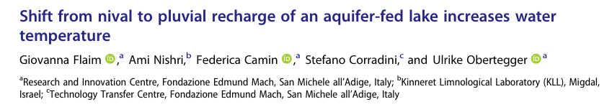

Slide 15



Applications:
Soil and tomatoes: organic vs conventional
DOI: 10.1016/j.foodchem.2020.126426
Strontium for the study of the interaction soil-apple DOI: 10.1002/jsfa.10399; DOI: 10.1021/acs.jafc.8b02604
Nitrogen for environmental studies
DOI: 10.2136/sssaj2003.1544

Slide 16
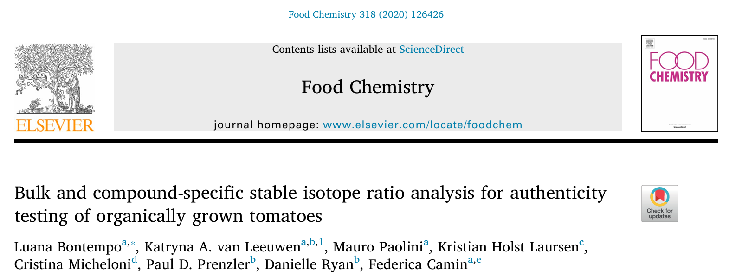
Bontempo et al., DOI: 10.1016/j.foodchem.2020.126426

Slide 17
48 TOMATOE + 8 SOIL SAMPLES
BASILICATA/EMILIA-ROMAGNA
ORGANIC/CONVENTIONAL
HARVESTED IN 2012/2013
ROMA/SAN MARZANO
Bontempo et al., DOI: 10.1016/j.foodchem.2020.126426

Slide 18
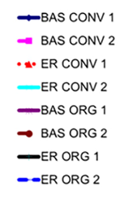
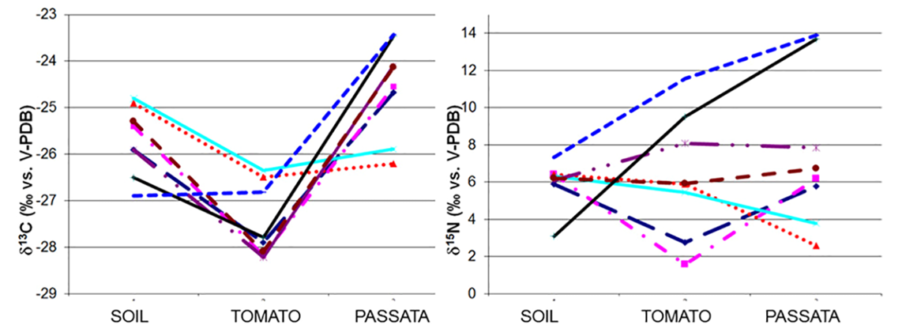
Fig. 1. Trend of stable isotope ratios of C and N determined along the production chain of tomato passata in soils, tomatoes and passata collected in 2012 (CONV/ORG 1) and 2013 (CONV/ORG 2) in two Italian regions (Basilicata BAS and Emilia Romagna ER).
Bontempo et al., DOI: 10.1016/j.foodchem.2020.126426
Notes:
13C diverso, perché C della pianta deriva principalmente da CO2 atmosferico, non da terreno; 15N invece non stat diverso tra terreno e pianta perche il 15N della pianta deriva da quello del terreno (non vale per le piante N2 fixing)

Slide 19
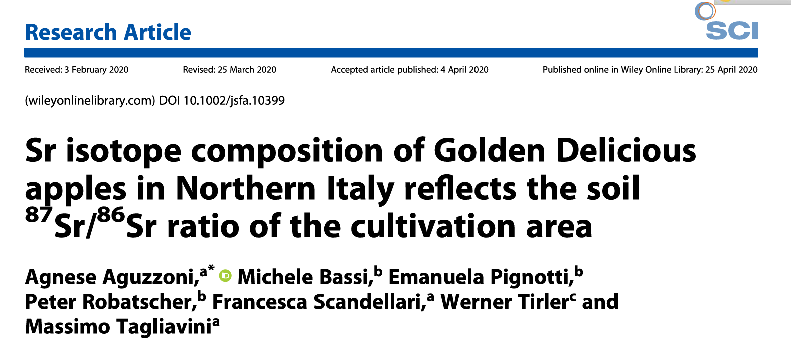
Aguzzoni et al, 2020; DOI: 10.1002/jsfa.10399

Slide 20
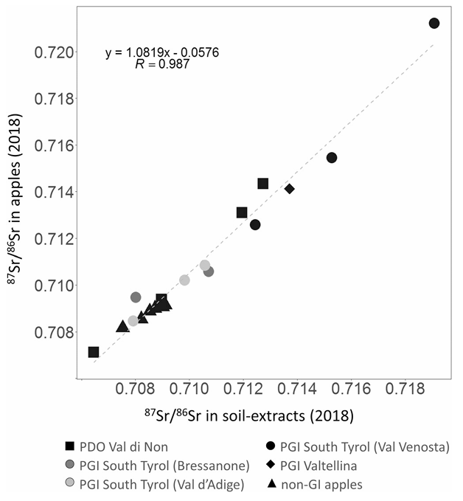
Aguzzoni et al, 2020; DOI: 10.1002/jsfa.10399
Figure 3. Linear correlation between the mean ⁸⁷Sr/⁸⁶Sr ratios of apple and soil extracts. Data are grouped according to the cultivation district.

Slide 21
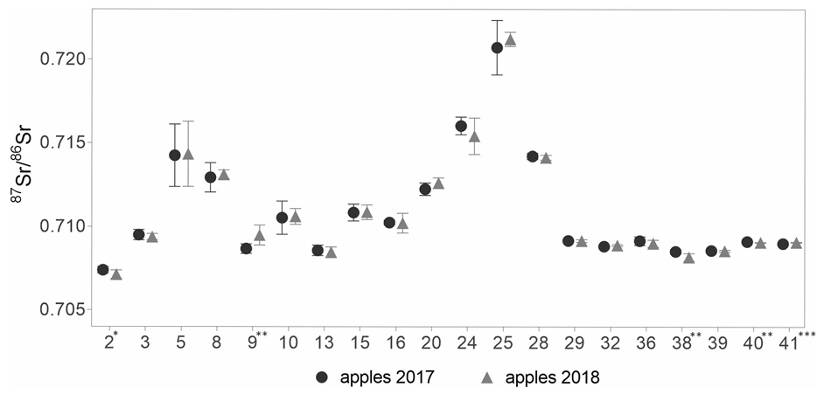
Aguzzoni et al, 2020; DOI: 10.1002/jsfa.10399
Figure 4. Comparison between the mean ⁸⁷Sr/⁸⁶Sr ratios of apples from two consecutive years (2017 and 2018) for each orchard. Orchards are numbered according to Table 1. Asterisks denote statistical significance: *P < 0.05, **P < 0.01, ***P < 0.001.

Slide 22
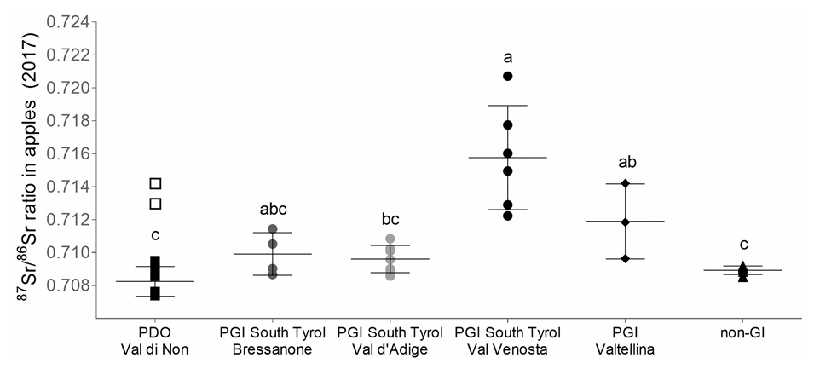
Aguzzoni et al, 2020; DOI: 10.1002/jsfa.10399
Figure 2. ⁸⁷Sr/⁸⁶Sr ratios measured in apple orchards (2017) grouped according to the cultivation district. Horizontal lines represent the mean ± SD of each district. Each symbol represents one orchard and is the mean of 10 apple samples. Open squares represent the two orchards in Val di Non excluded from the mean calculation and the analysis of variance among cultivation districts. Different letters indicate a significant difference among districts (P < 0.05).

Slide 23
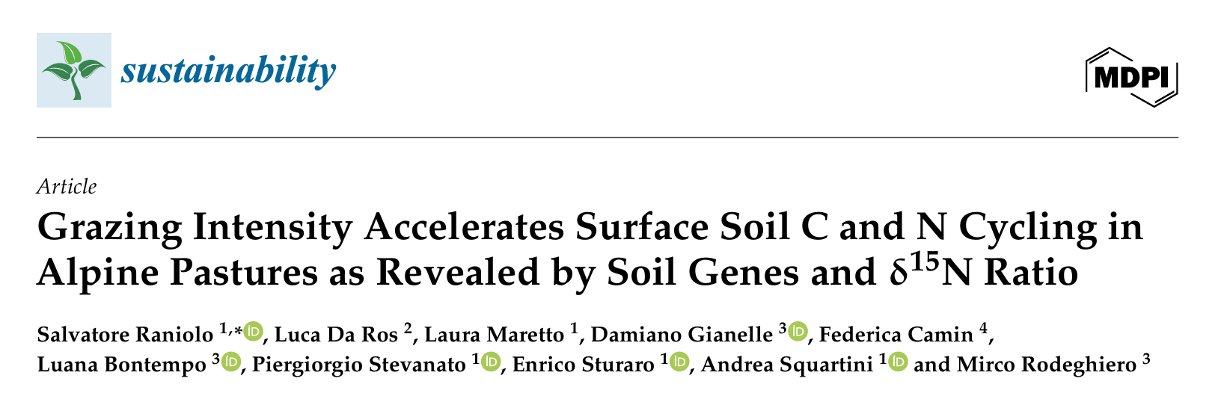
Raniolo et al., 2025; DOI: 10.3390/su17052165

Slide 24
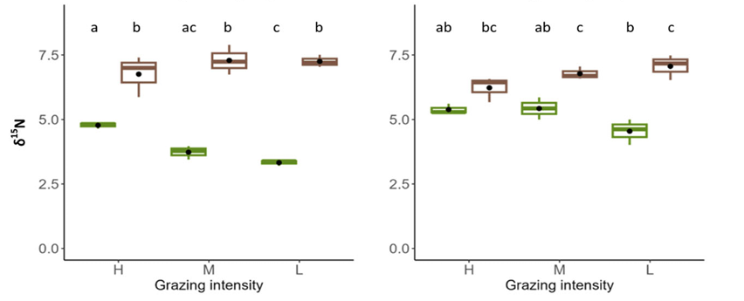
Figure 3. Mean values of δ¹⁵N as a function of the 2-way interactions between grazing intensity and soil depth (grazing intensity: H = high; M = moderate; L = low; soil depth: S = superficial layer; D = deep layer) in 2018 and 2020.
Raniolo et al., 2025; DOI: 10.3390/su17052165

Slide 25
Applications:
Soil and tomatoes: organic vs conventional
DOI: 10.1016/j.foodchem.2020.126426
Strontium for the study of the interaction soil-apple DOI: 10.1002/jsfa.10399; DOI: 10.1021/acs.jafc.8b02604
Nitrogen for environmental studies
DOI: 10.2136/sssaj2003.1544

Slide 26
Thank you for your attention
silvia.pianezze@fmach.it

